Slide 1
If - elif - else
Real applications making decisions

Slide 2

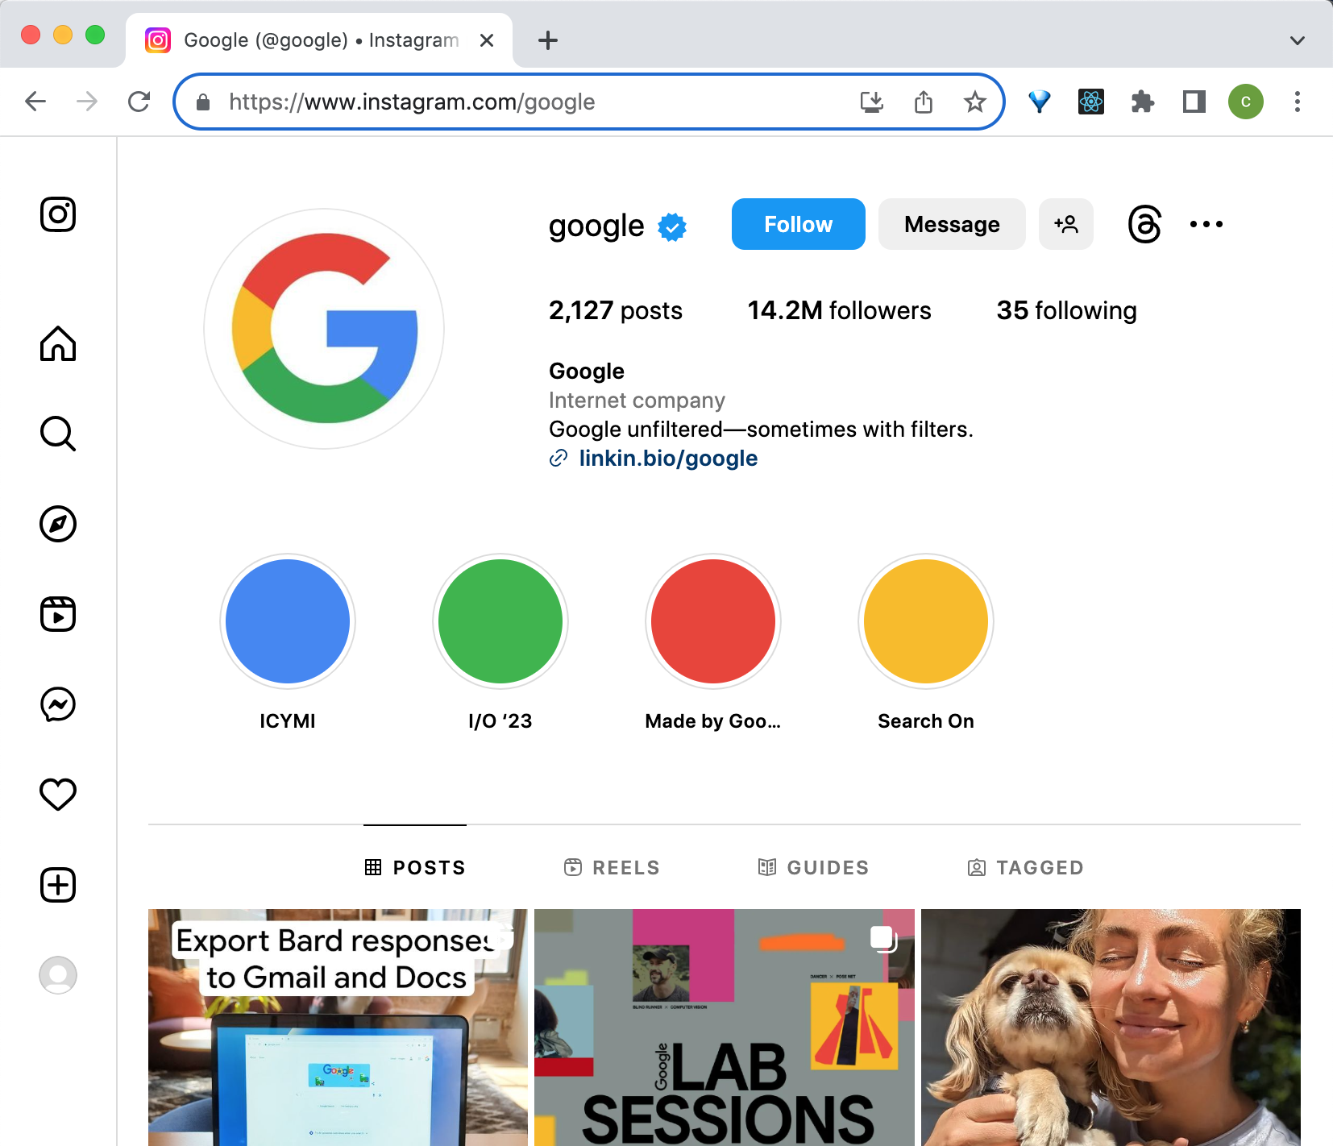
Let's use Instagram again
Last time, we looked at where variables are being used, and we looked at two different accounts and where the data on the page was different
We also thought about how users might set the value of variables with their actions, and user input
These pages must be using a variable for the account username
The page layouts are the same, the username text is different

Slide 3
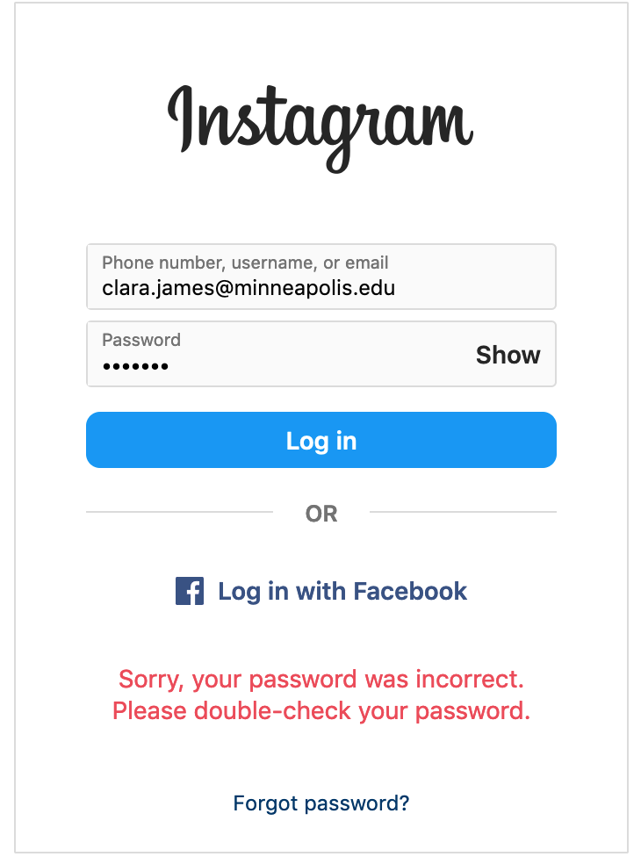
Where does an application, like Instagram, make decisions?
When it might do something different based on the value of a variable (or variables)
Variable values are often set from user input
For example, it can look at user input and take an action based on the user's input
For example, the user tries to log in.
The username is stored in a variable, the password is stored in another variable
If the password is the correct one for the username entered, the user with that username is will be logged in
Else, the app will show an error message

Slide 4
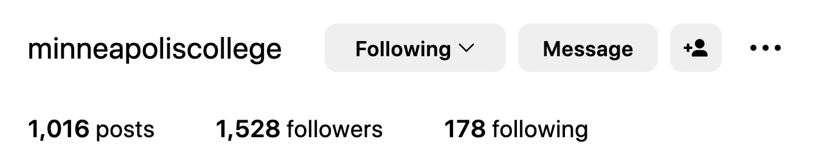
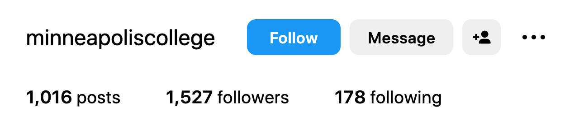
Where does an application , like Instagram, make decisions?
It might do something different based on the value of a variable (or variables)
The value of variables could already be known to the application
For example, a user already follows another account. Instagram saved that information
Then, the user views that account today, the application will check if they already follow this account
If they already follow this account, they'll see the follow button in gray showing the text "Following"
else, they'll see follow button in blue showing the text "Follow"
If the user already follows this account, show "Following" and the button in gray
else, (they do not already follow this account) show the text "Follow" and the button in blue

Slide 5
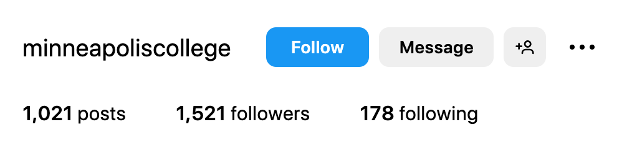
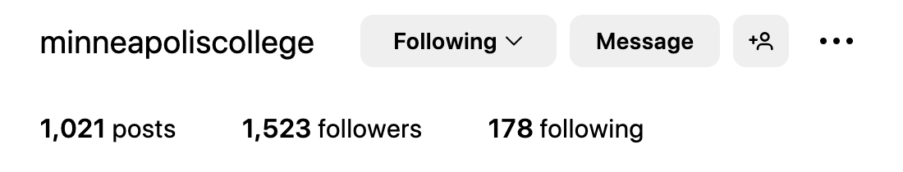
Following an account
When someone follows an account, the number of followers changes
So, the value of a variable that represents the number of followers changes,
And, a variable that represents whether I follow this account or not changes
So, the follower count changes,
And the buttons change - the text says "Follow" or "Following", and the color is different, based on if I'm following an account or not,

Slide 6
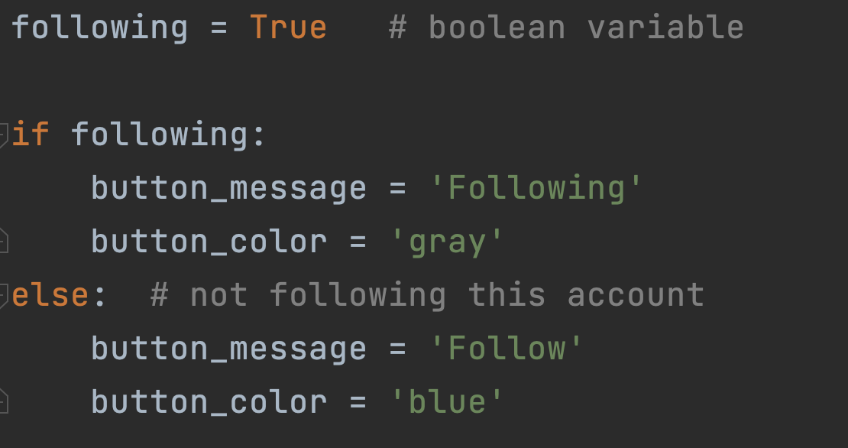
Following or not - deciding what the button shows

Slide 7

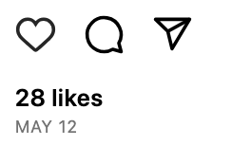
Displaying a "like" icon
It might do something different based on the value of a variable (or variables)
The value of variables could already be known to the application
For example, a user liked a post yesterday
Instagram saved that information
Then, the user views the same post today, the application will check if they already liked it or not
If they already liked the post, they'll see the heart icon in red
else, they'll see the outline heart icon
If they already liked the post, show heart icon in red
else, (they did not already like the post) show the heart icon outline

Slide 8
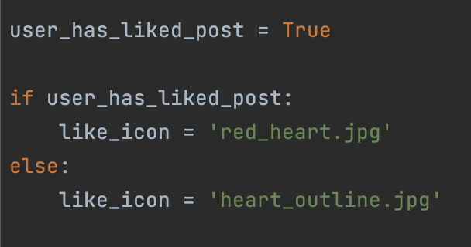
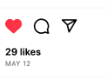
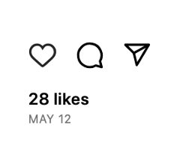
Example code - boolean variable
What type of variable can store if a user has liked a post or not?
We can use a bool (boolean) variable
A bool can only have the values True or False
In this application, for a specific post, when the user_has_liked_post variable is set to True, then they means that they have liked this post
when the user_has_liked_post variable is set to False, then they means that they not have liked this post

Slide 9
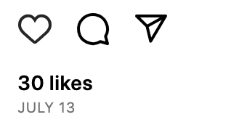
Like message
If post_likes is 30,
then message will be the string '30 likes'

Slide 10
Like message
That works well for 30 likes, or any number that's more than 2
What if there's one 1 like? This code will create a message '1 likes' which isn't grammatically correct
What about if there are 0 likes? What does Instagram say?

Slide 11
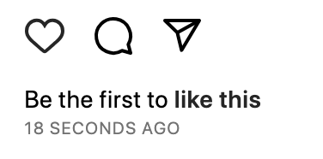
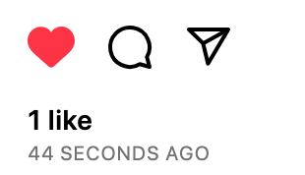
Like message
What if there are 0 likes? The message should be 'Be the first to like this'
Else, what if there's one 1 like? The message should be '1 like'
Else, there must be more than one like, the message should be in the form '30 likes' or '42 likes'
We need an if - elif - else statement

Slide 12
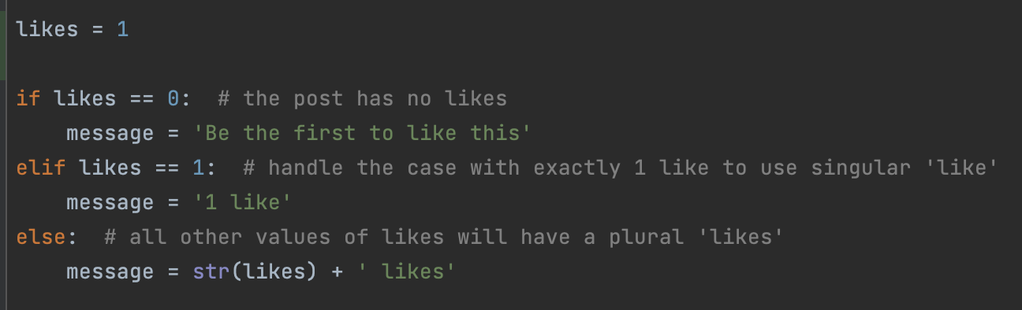
Like message
There are three possible options
An if, elif, else statement can be used

Slide 13
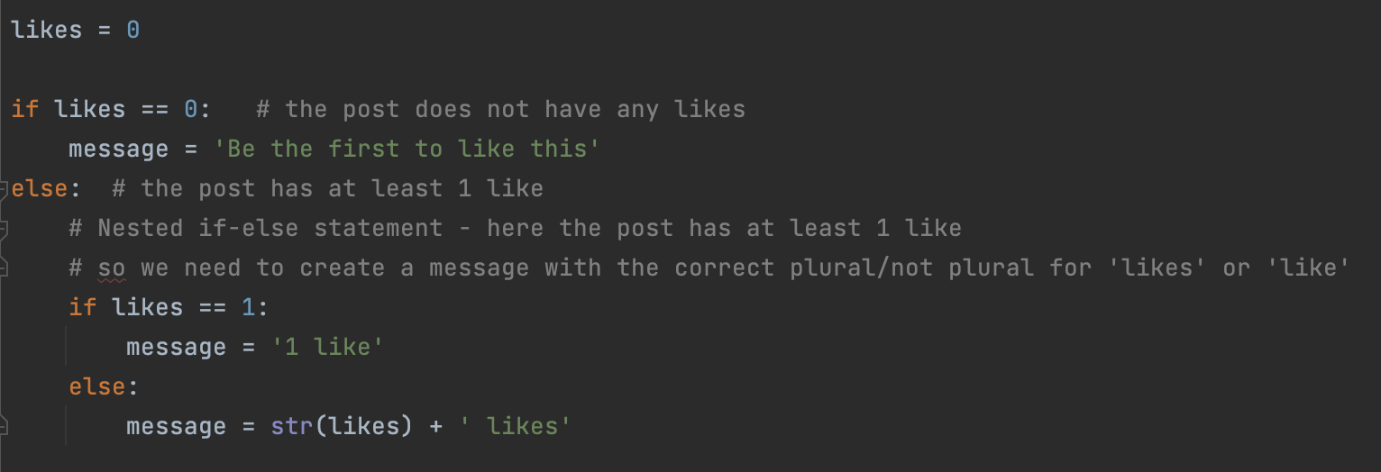
Another way - nested if statements
Either the post doesn't have likes, or it does have likes - so an if-else
When the post does have likes, use a nested if-else to create a message with the correct word based on the number of likes, 'like' or 'likes'

Slide 14
Both of those versions are correct
They both create the same message for a given number of likes
Which one do you prefer?
The one that makes most sense to you is the right one to use
Be careful with indentation when you use nested if statements
Adding comments to your code is very helpful!

Slide 15
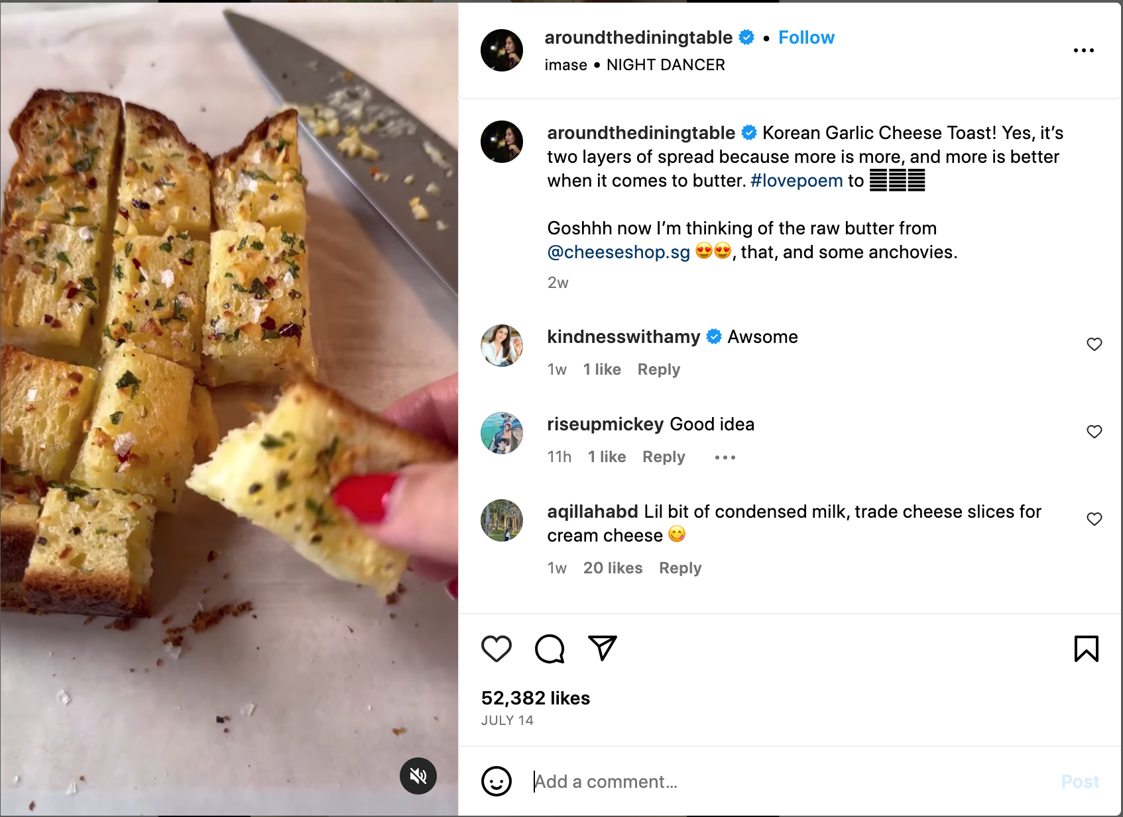
Making checks - is the user allowed to take an action?
Can I add an empty comment to a post?
Is the Post button enabled before I've typed anything?
No - it's in a lighter color, and doesn't do anything when clicked
https://www.instagram.com/p/Cus7lLzNj6C/

Slide 16
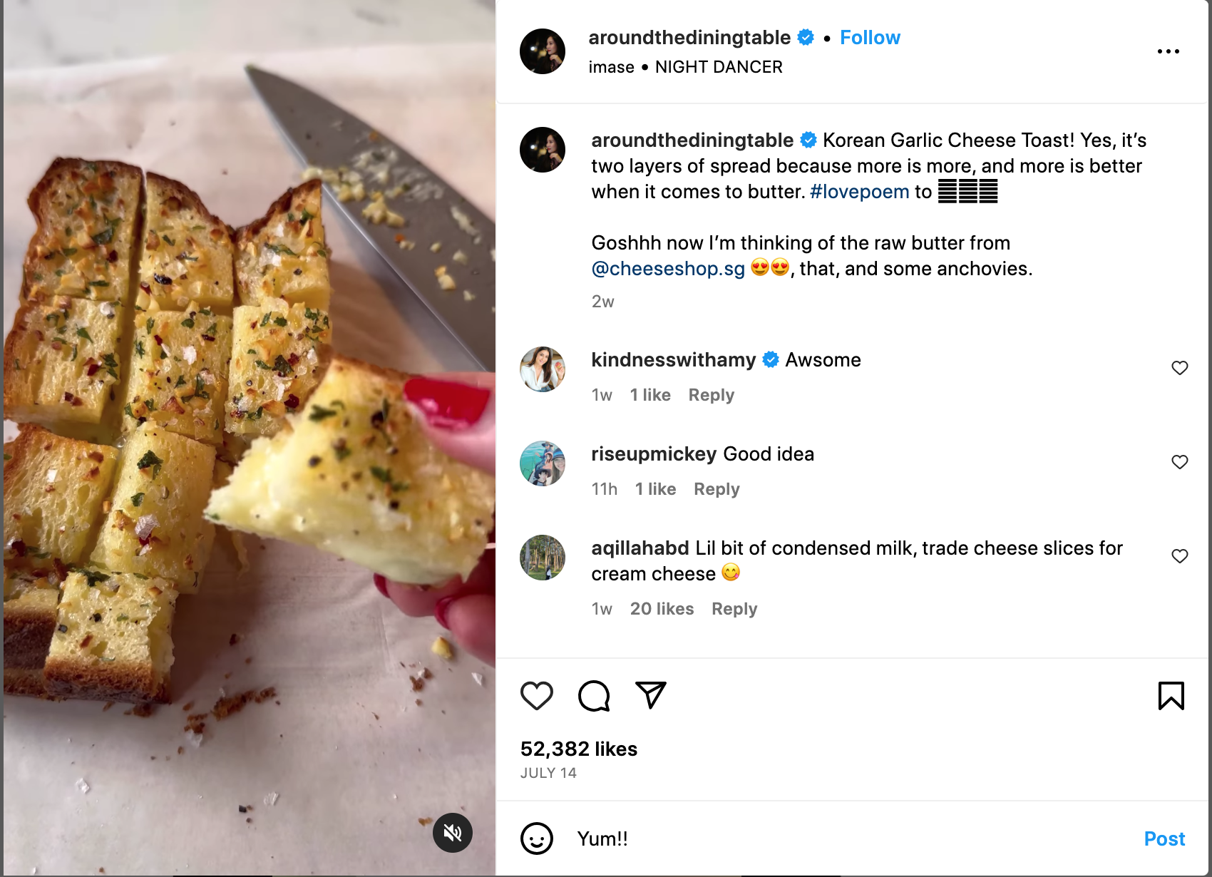
But when I type at least one character….
The Post button turns blue, and is enabled, so the comment will be posted when I click it

Slide 17
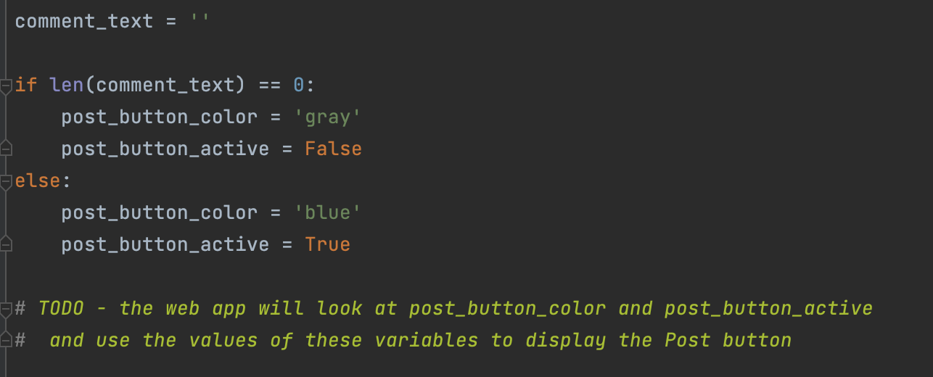
So, there must be a condition that is checking the length of the comment
The web page could use the value of these two variables to set the color of the button, and whether it is enabled or not

Slide 18
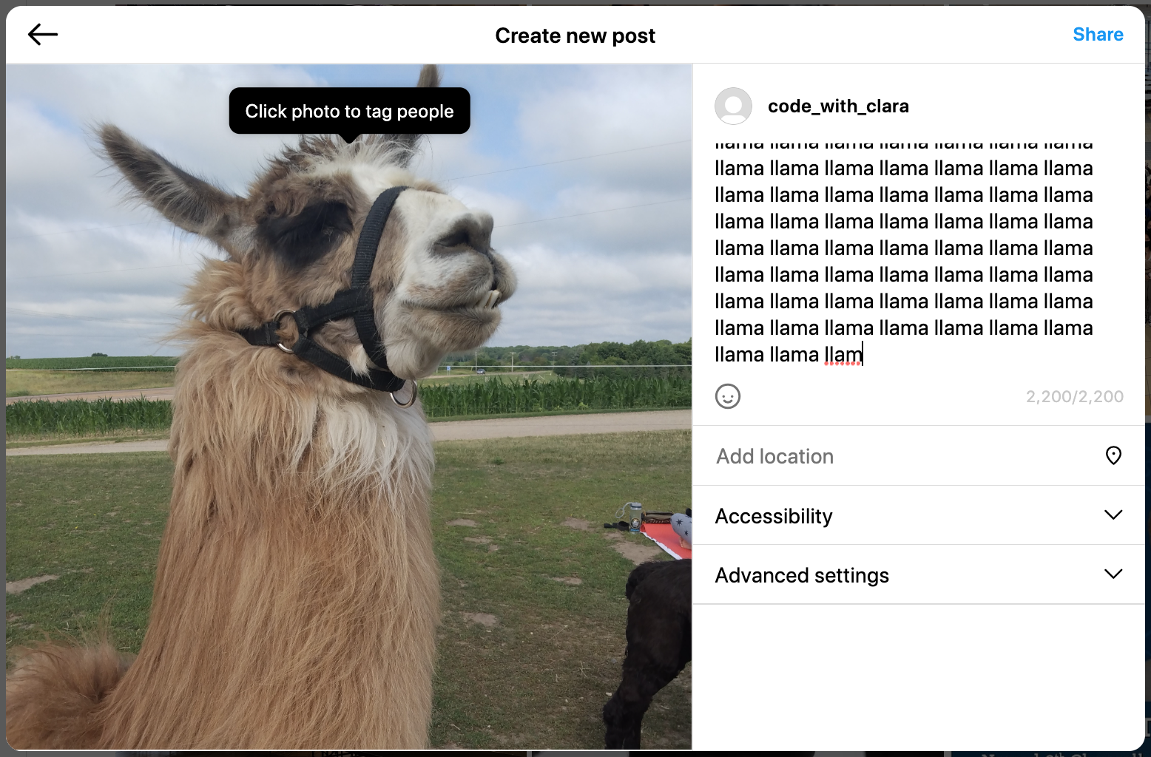
What about the maximum length of a new post description text?
The limit is 2,200 characters, what happens if we try and paste in a really long string that's more than 2,200 characters?
Instagram cuts off any characters past the 2200th character
Else, what does it do?
Nothing, the text is within the maximum length limit, so it is not modified

Slide 19
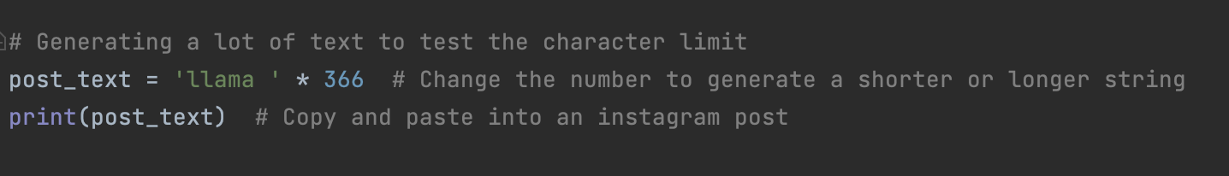
What's the easiest way to generate a long piece of text for testing this?
Typing 2200 characters
Or we can use Python!
The * symbol can be used with a string and an int to make multiple copies of a string. A new string is created, and can be assigned to a new variable

Slide 20
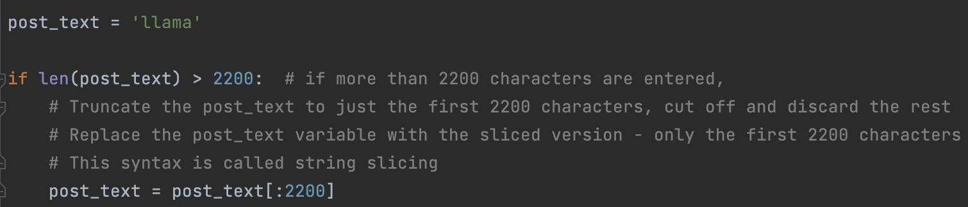
If text is too long, modify so it's only the first 2200 characters
The post_text[:2200] syntax is called "string slicing". More info at
https://www.digitalocean.com/community/tutorials/python-slice-string

Slide 21
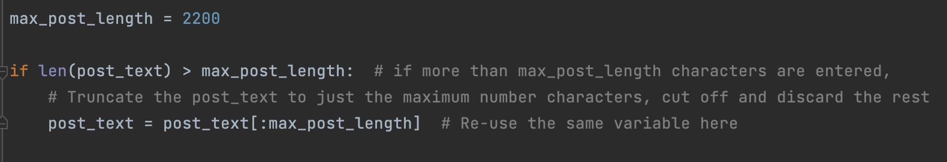
We can improve on this code
The number 2200 is used twice
Let's replace it with a variable that stores 2200
The condition in an if statement can compare two variables

Slide 22
Advantages of using a variable instead of the number directly
It describes what the number 2200 represents - the maximum post length
If the maximum post length changes, we just need to change the variable in one place
Compare to the previous version where we would have to make the change in two places. That doesn't sound like a lot, but some data might be used in lots of different places and if you have to make changes everywhere, that's a lot of work, and it's easy to miss one by mistake and now you have a bug in your program.
If we need to know the maximum post length somewhere else in the program, we have a convenient variable that stores the data for us

Slide 23
If statements
Used when a program needs to make a choice based on the value of a variable - or variables
The value of the variable can be set by what the user does
Or, the application might calculate the value of variable(s)
Or, the application might already know the value of variables(s)
We might write an if statement, to do something in some circumstance
We can use if-else to choose between two options
We can use if-elif-else to choose between three or more options
We can use conditions with variables and data, or variables and other variables
Where else can you see examples of Instagram making choices? What variables and data do you think it might be using?
Where else do you think the applications you use, make choices?

